Slide 1
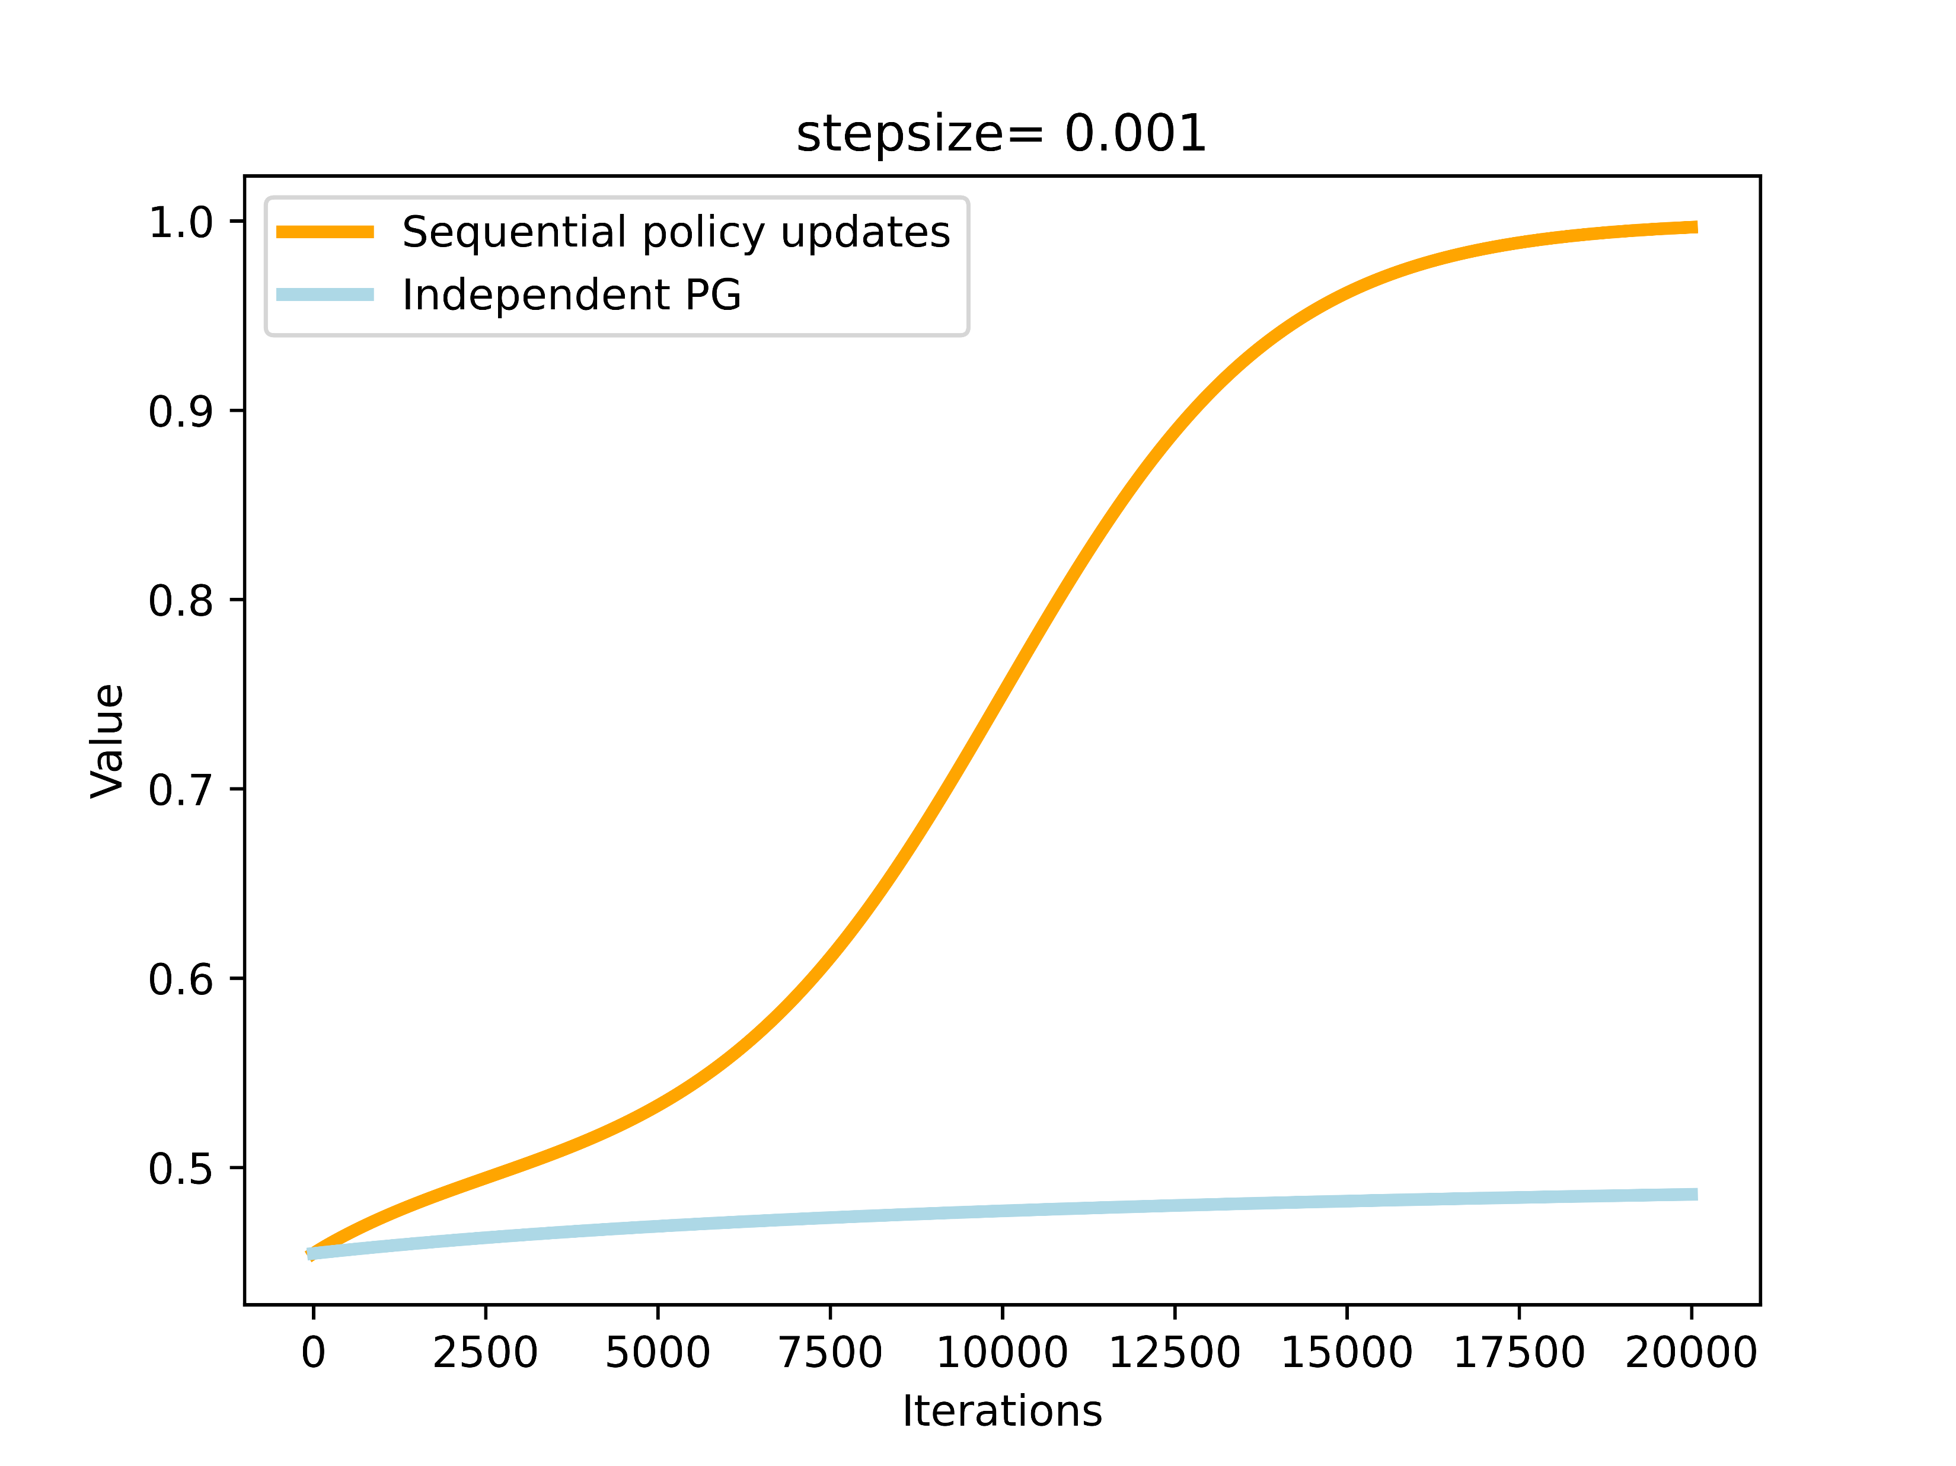
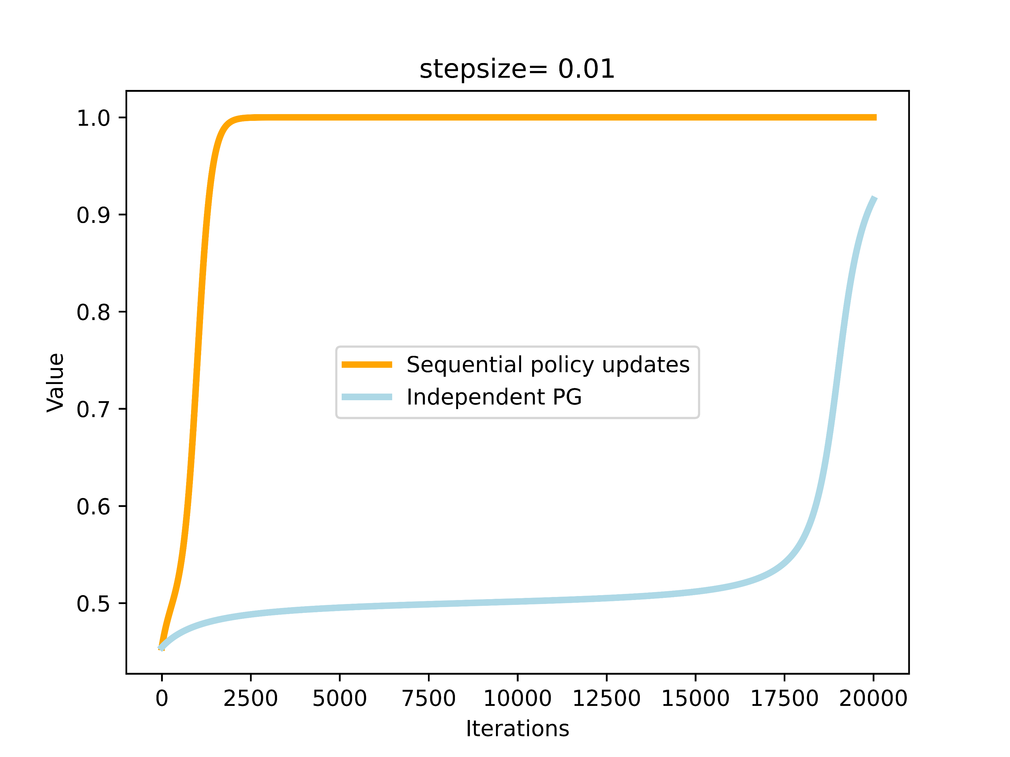
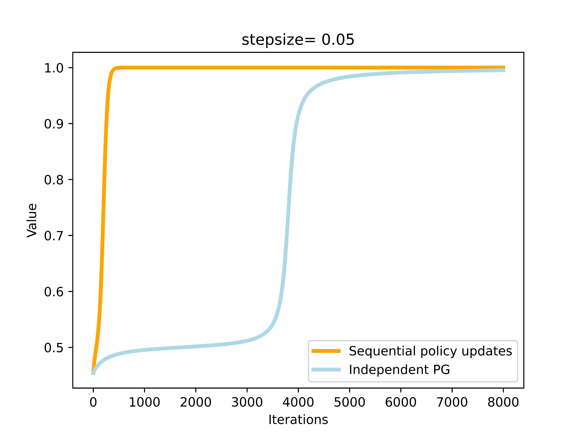
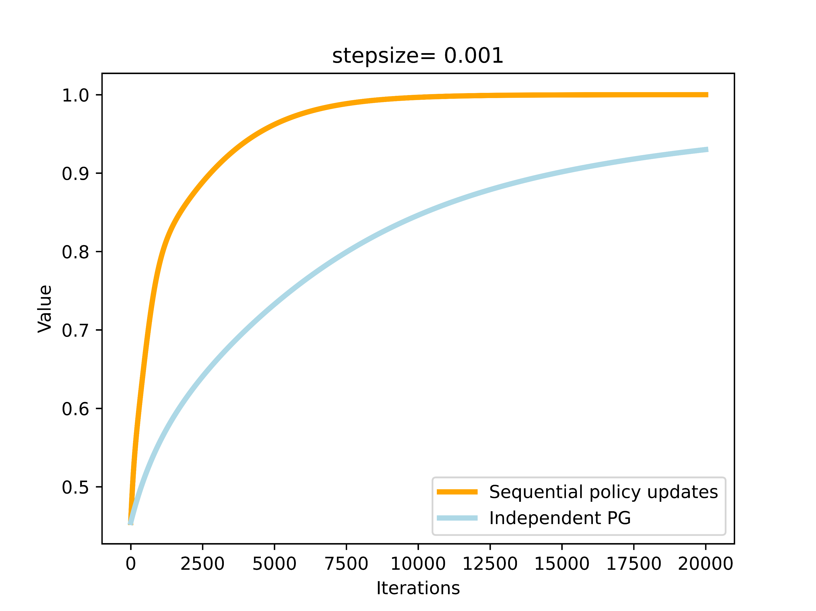
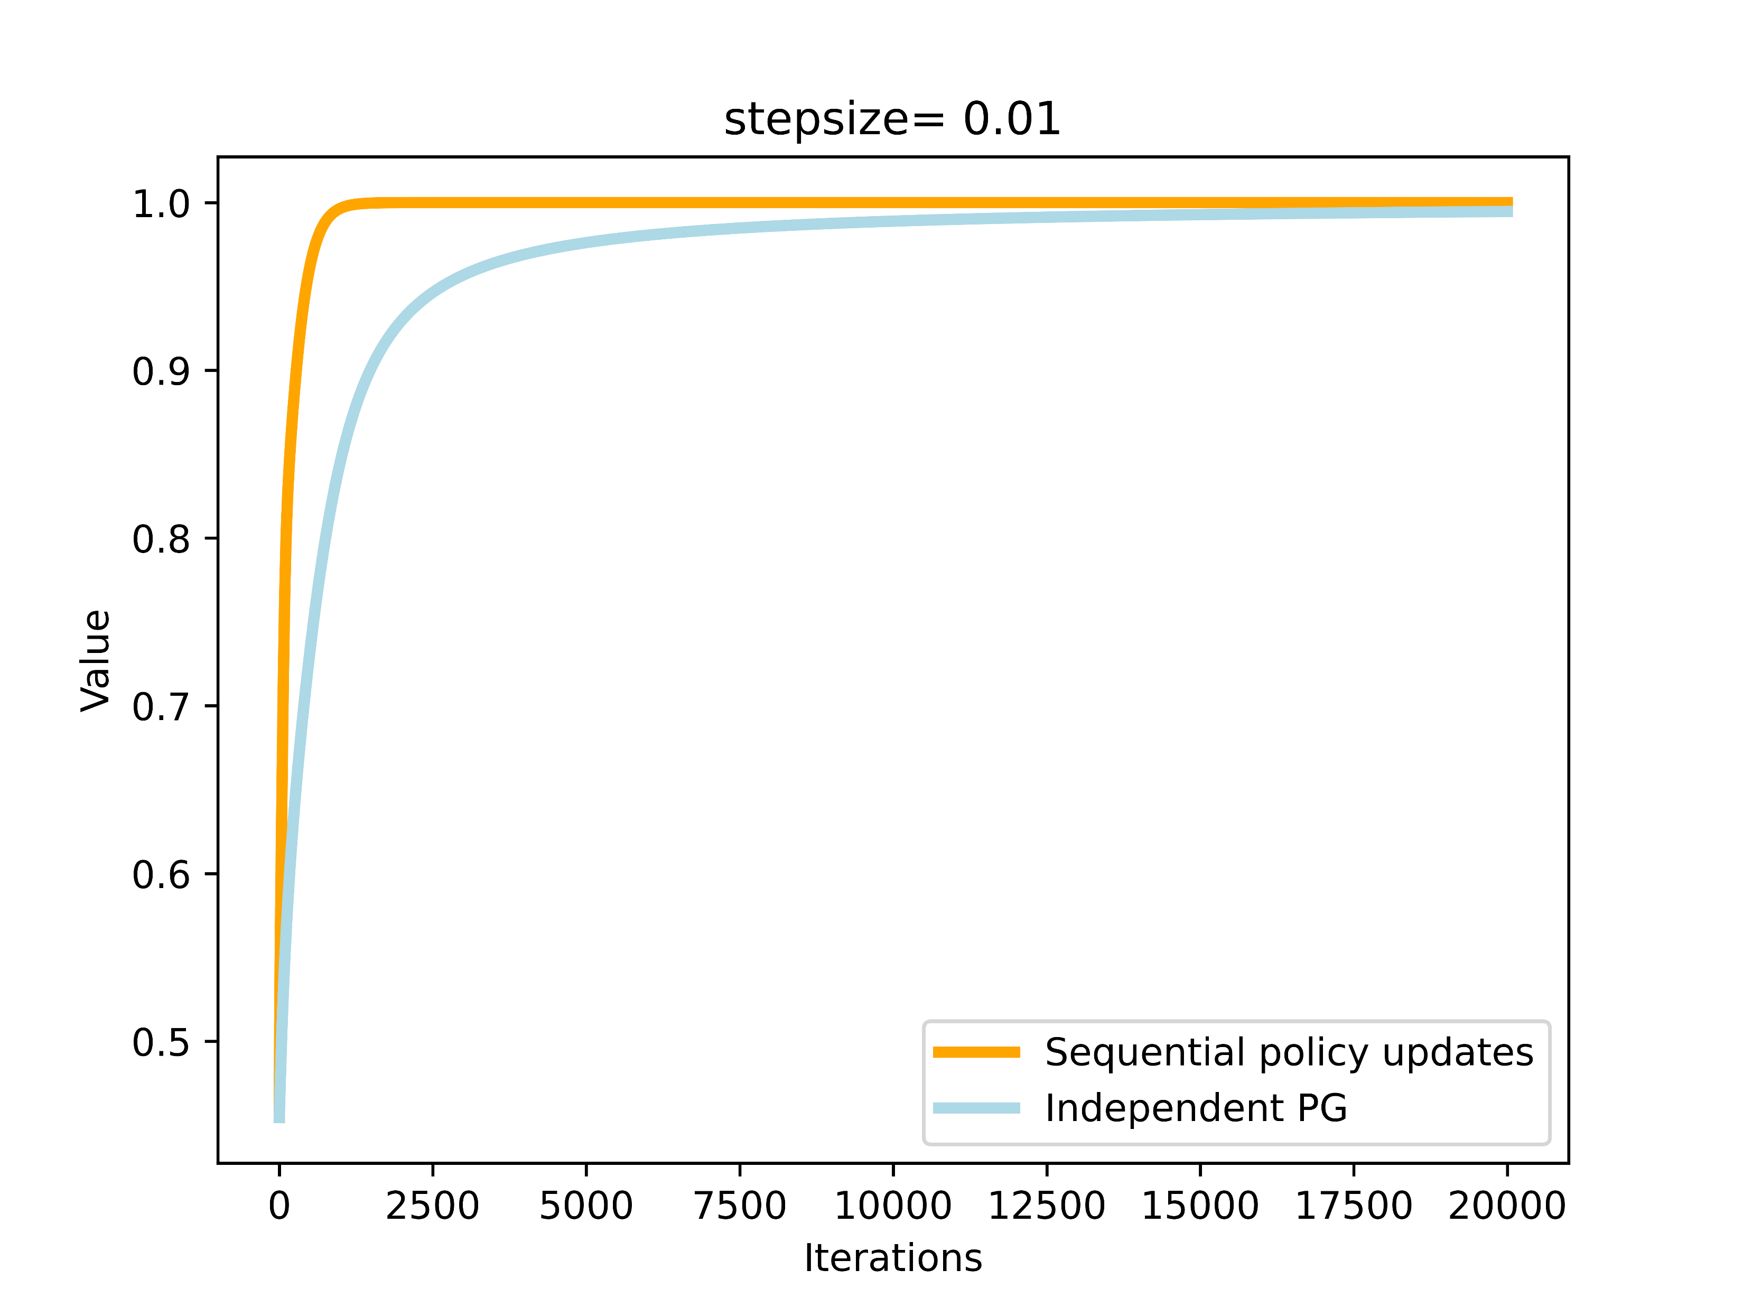
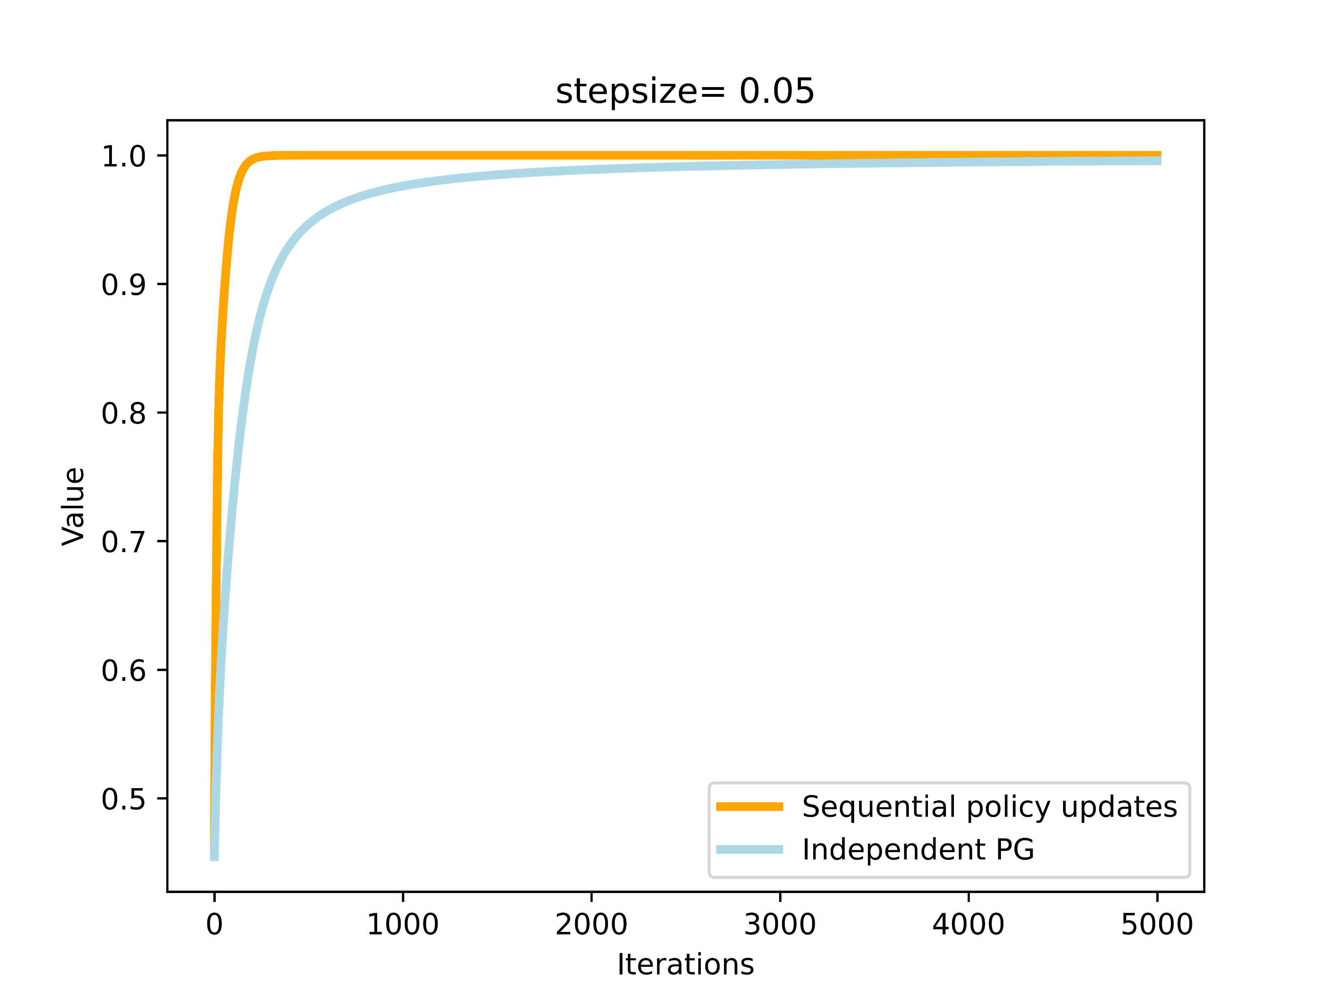
a
b
c
d
e
f
(a)-(c): policies are initialized close to the stationary point.
(d)-(f): both policies are uniformly initialized.
From (a)-(c), we find that independent PG often has difficulty escaping the stationary point that is not necessarily globally optimal. In this example, a bigger stepsize would help alleviate the issue (e.g., in (c), independent PG escapes the stationary point after 3000 iterations). However, the convergence to global optima is still slower than our method.
From (d)-(f), we find that though independent PG is not trapped by a stationary point, our algorithm still consistently outperforms independent PG in maximizing the value function.

